Slide 1


Natural gas v alternative routes for production of chemicals in 2022
Institute for Chemical and Bioengineering
Sustainable Process Systems Engineering Lab
Abhinandan Nabera
28. October 2022

Slide 2
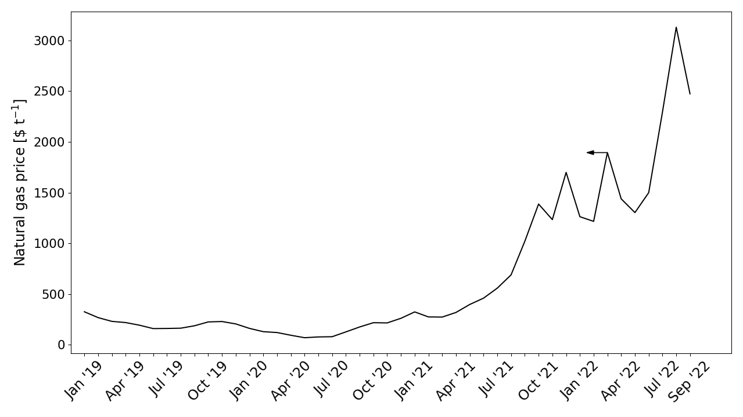
Natural gas prices have increased sharply
Aftermath of COVID-19
Soaring inflation
Climate change
War on Ukraine

Slide 3
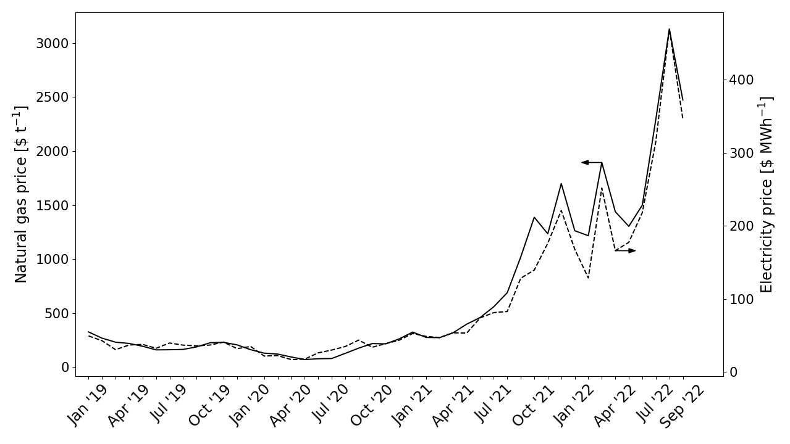
Natural gas contributes around 20.5% towards the electricity mix…
As of 2021, 20.5% of the electricity comes from natural gas in the EU.
Electricity prices have also increased sharply following a similar trend.

Slide 4
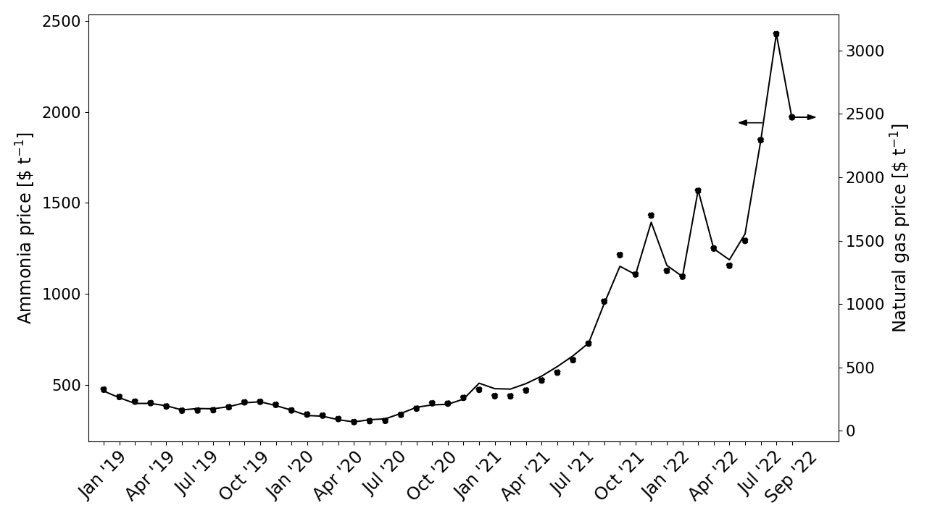
As a result, ammonia production from natural gas (BAU) has become expensive…
1 kg of ammonia requires 0.43 kg of NG as feedstock and 0.10 kg of NG for heating
Also, 1 kg of ammonia requires 0.94 kWh of electricity

Slide 5
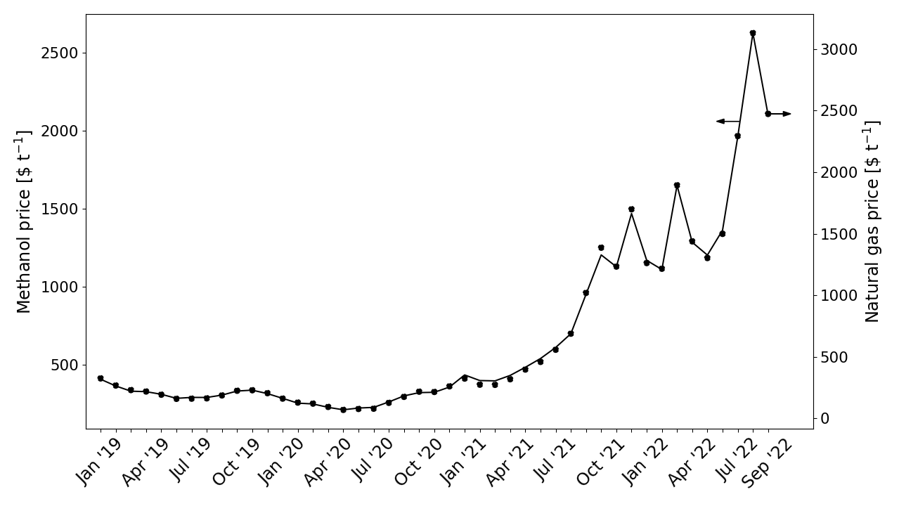
Also, methanol production from natural gas (BAU) has become uneconomical…
1 kg of methanol requires 0.61 kg of NG as feedstock and 0.05 kg of NG for heating
Also, 1 kg of methanol requires 0.71 kWh of electricity

Slide 6
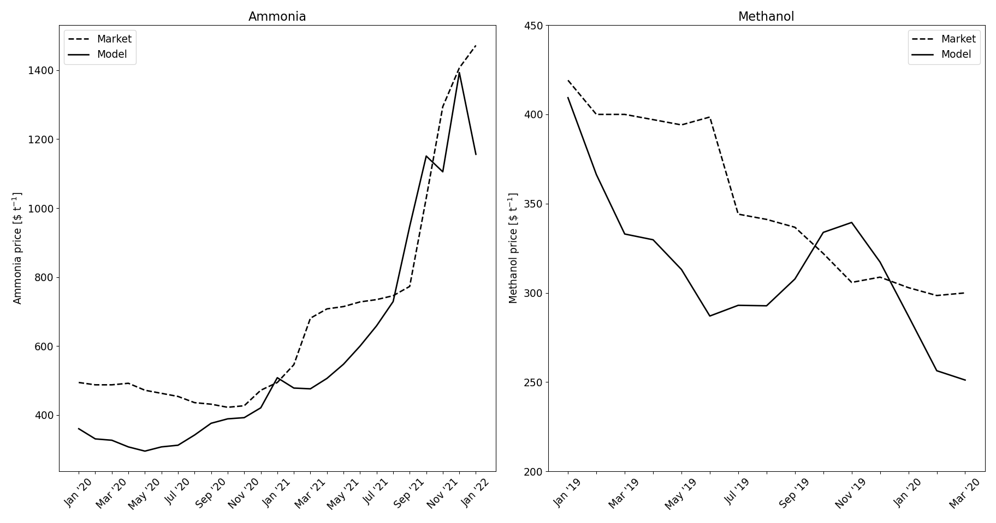
Model validation

Slide 7
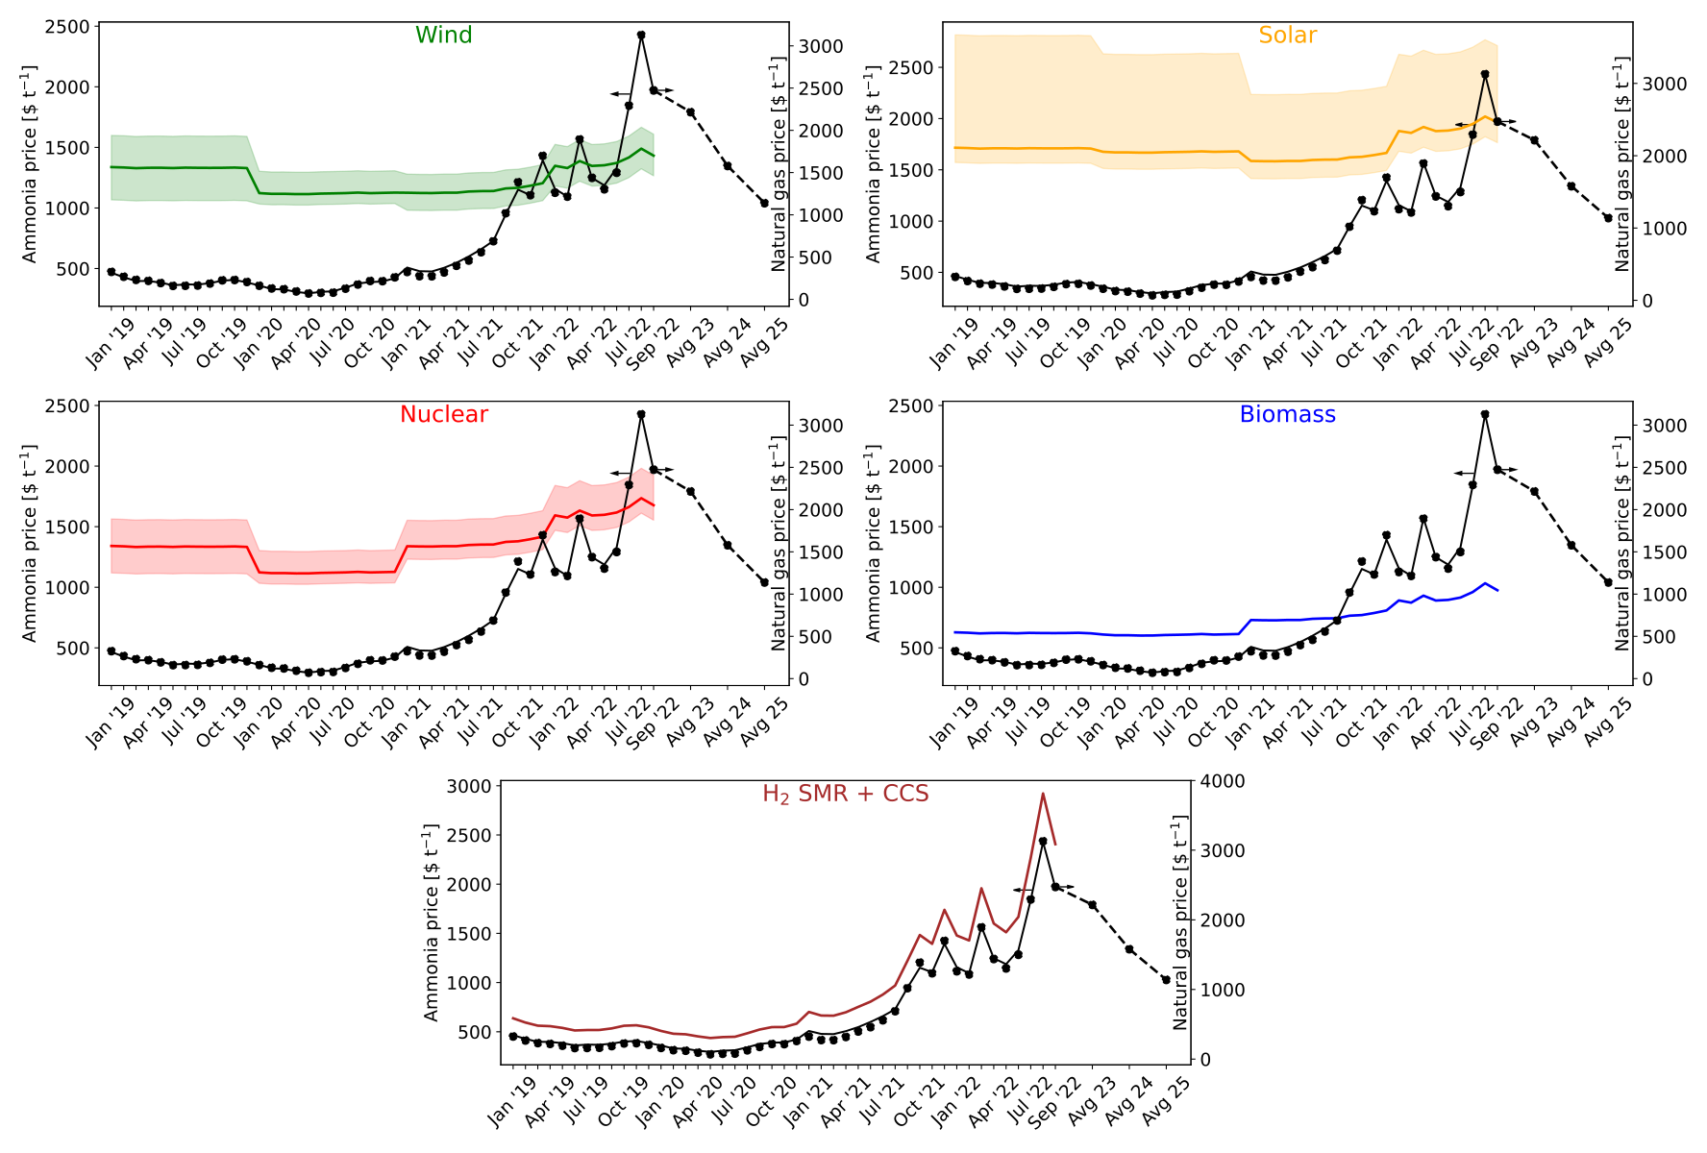
Green ammonia is more feasible in the current scenario economically…
LCOE values for solar and wind obtained from IRENA for the respective years
LCOH values calculated
LCOH values for nuclear and biomass obtained from Parkinson and adjusted for inflation

Slide 8
Green ammonia is more feasible in the current scenario economically…
Renewable electricity is only used for the electrolyzer and the electricity mix is used for the process itself
The process consumes 0.47 kWh of electricity per kg of ammonia

Slide 9
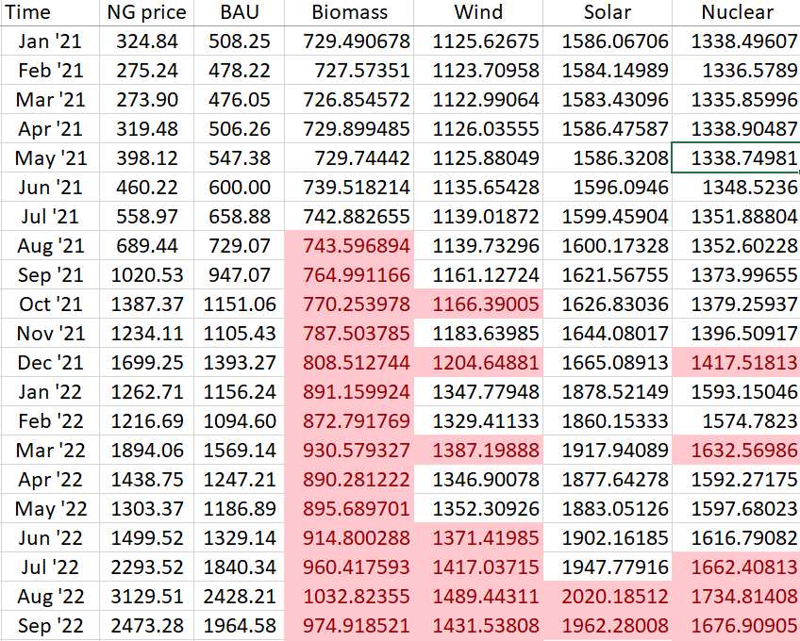
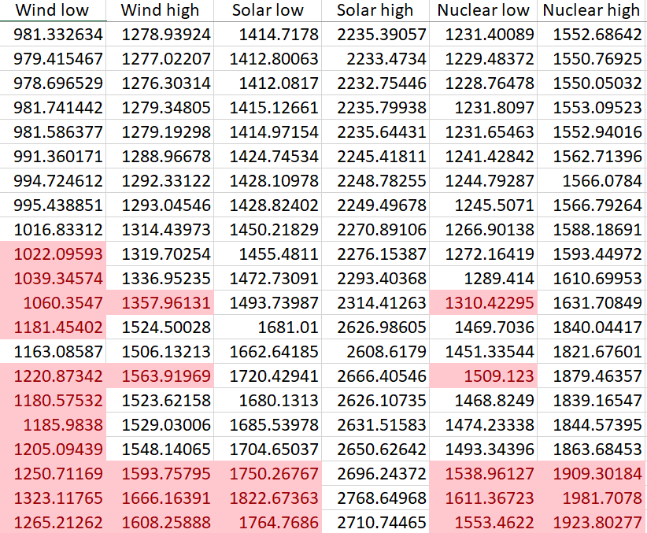
Green ammonia is feasible not only at the peak of natural gas prices

Slide 10
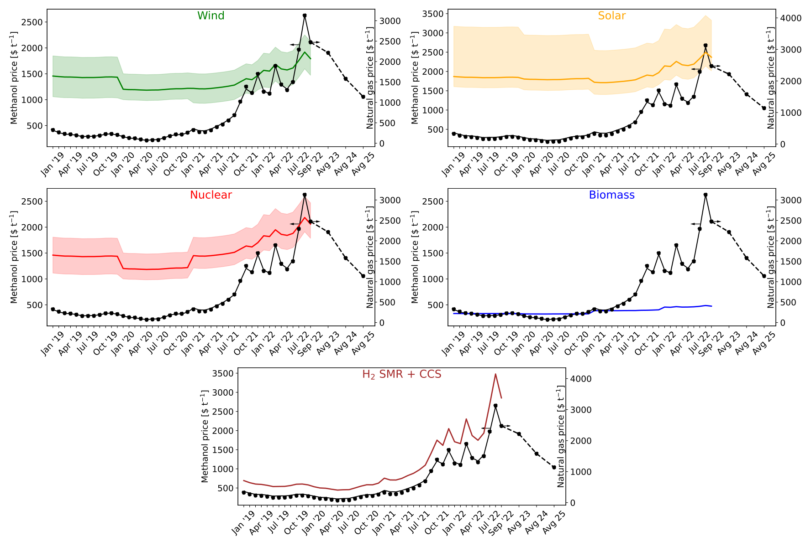
Green methanol is competitive in the current scenario
Carbon dioxide from DAC
Carbon dioxide itself requires 0.11 kg of NG per kg
The process consumes 0.17 kWh of electricity per kg of methanol

Slide 11
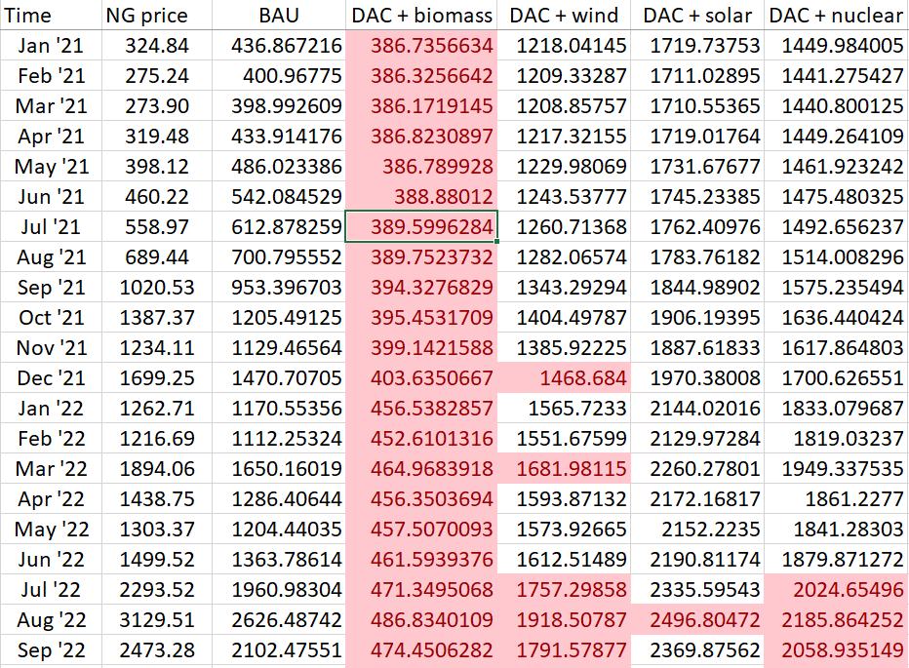
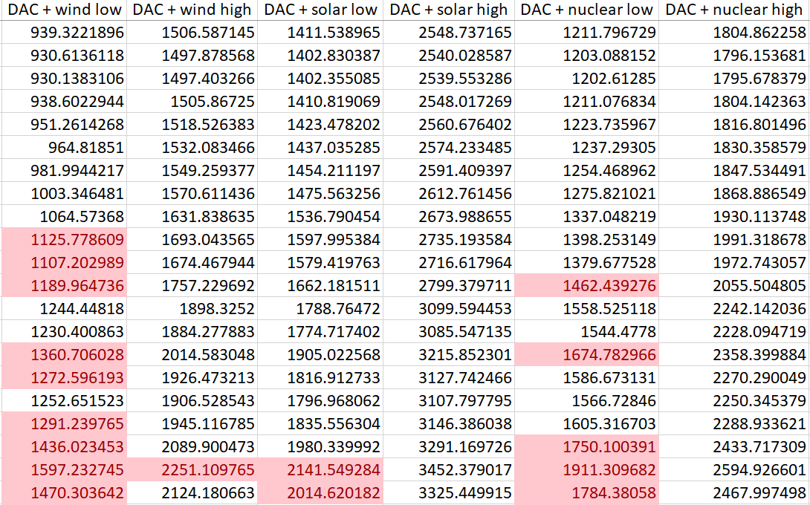
Green methanol is feasible not only at the peak of natural gas prices

Slide 12
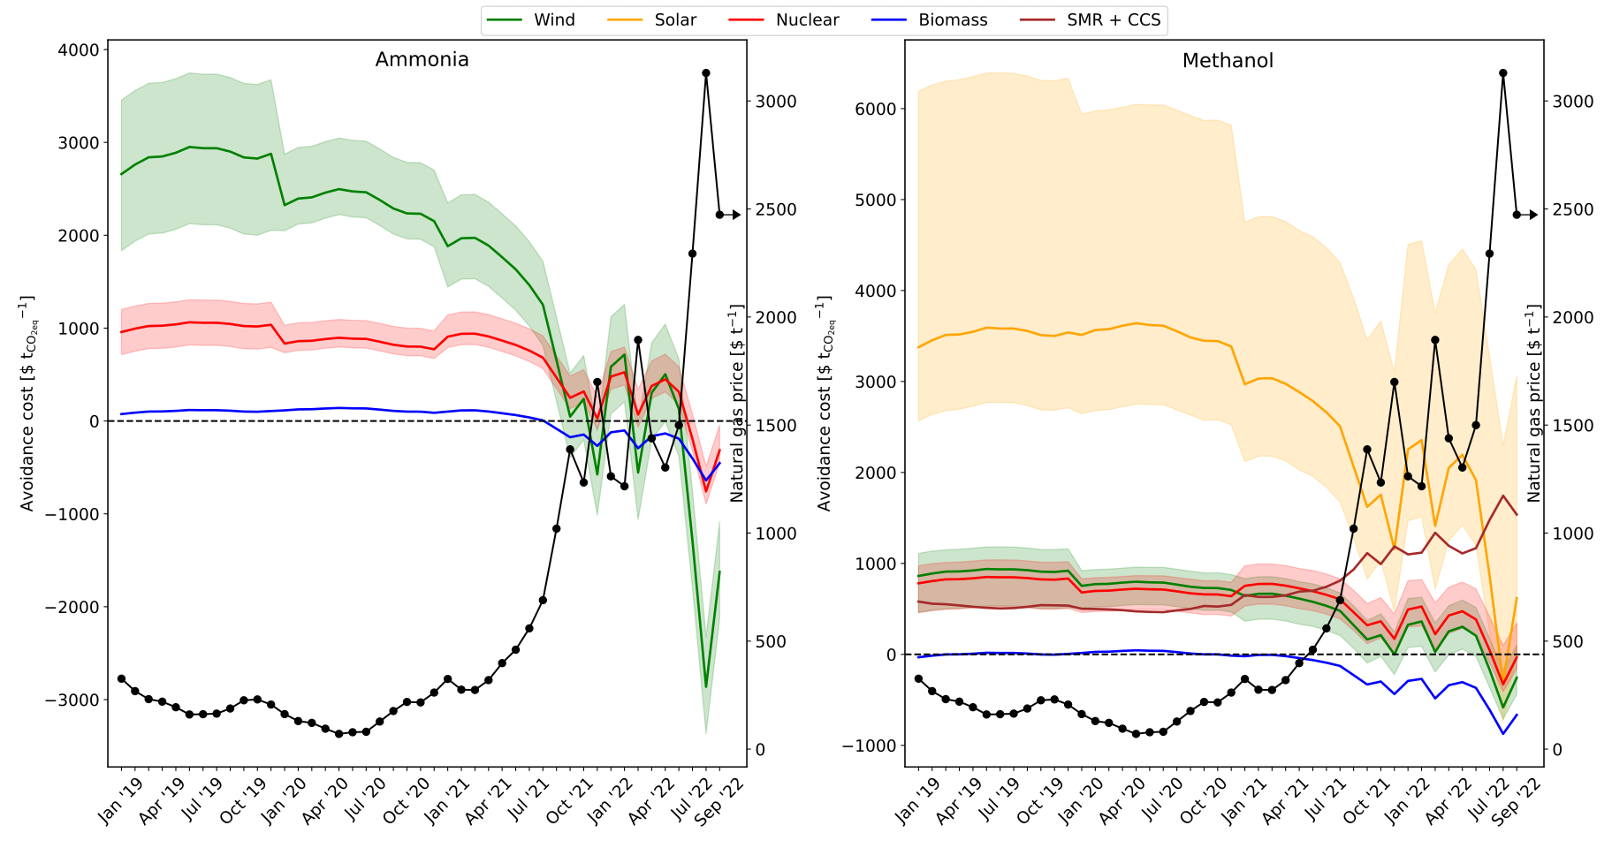
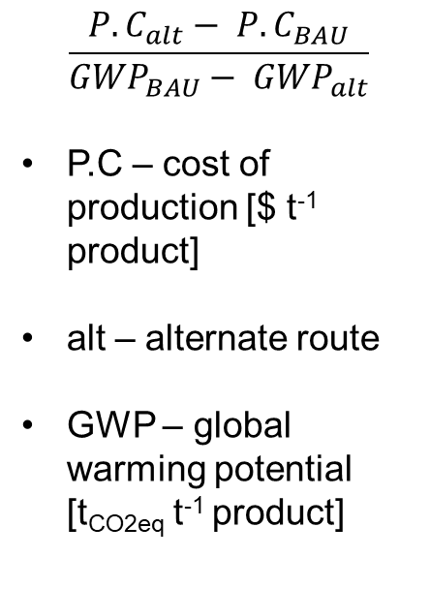
Save money by using green routes
$$\frac{{P.C}_{alt}− {P.C}_{BAU}}{{GWP}_{BAU}− {GWP}_{alt}}$$
P.C – cost of production [$ t⁻¹ product]
alt – alternate route
GWP – global warming potential [t_{CO2eq} t⁻¹ product]

Slide 13
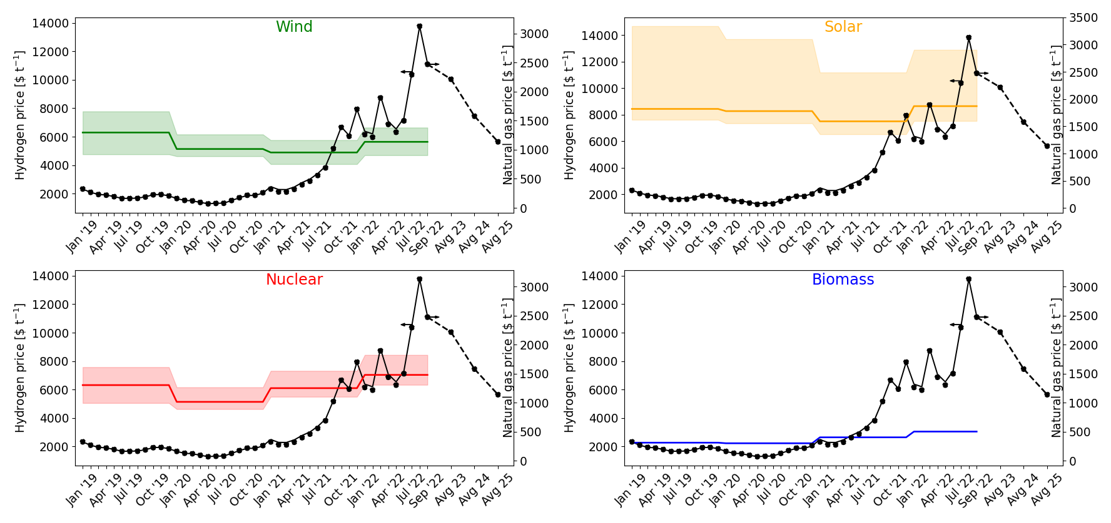
Green hydrogen

Slide 14
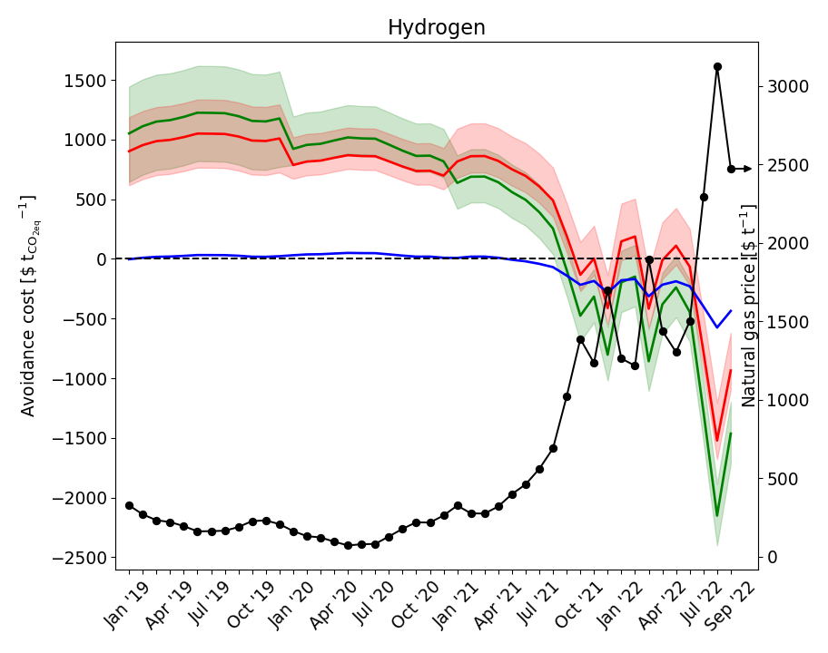
Green hydrogen avoidance costs

